Slide 1

Evaluating Business Ratings & Preferences Across Shopping Categories
Group8

Slide 2
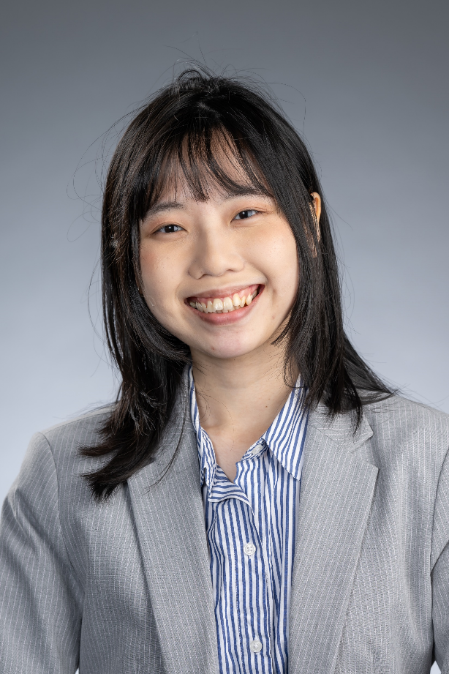


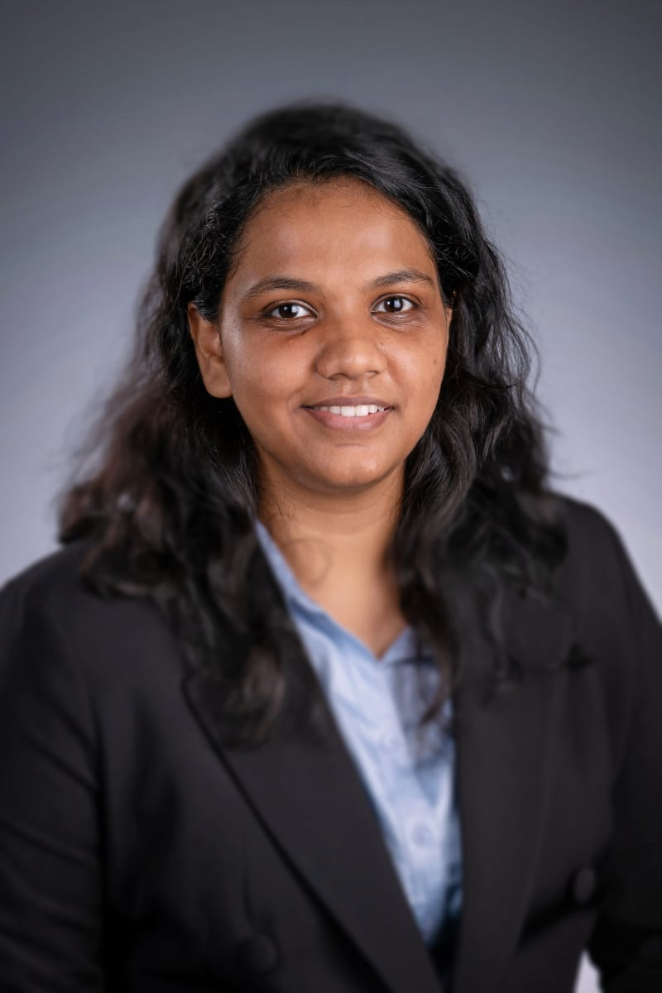
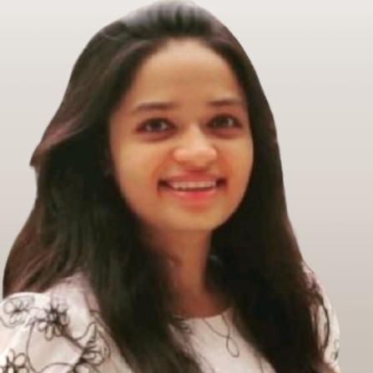
Our Team
Yu-Chin Chen
Harsh Kevadiya
Balbir Singh
Maria Sequeira
Rasika Teli

Slide 3
Agenda
Business Problem
Data Preparation
Exploratory Data Analysis
NLP
Results & Business Insights

Slide 4
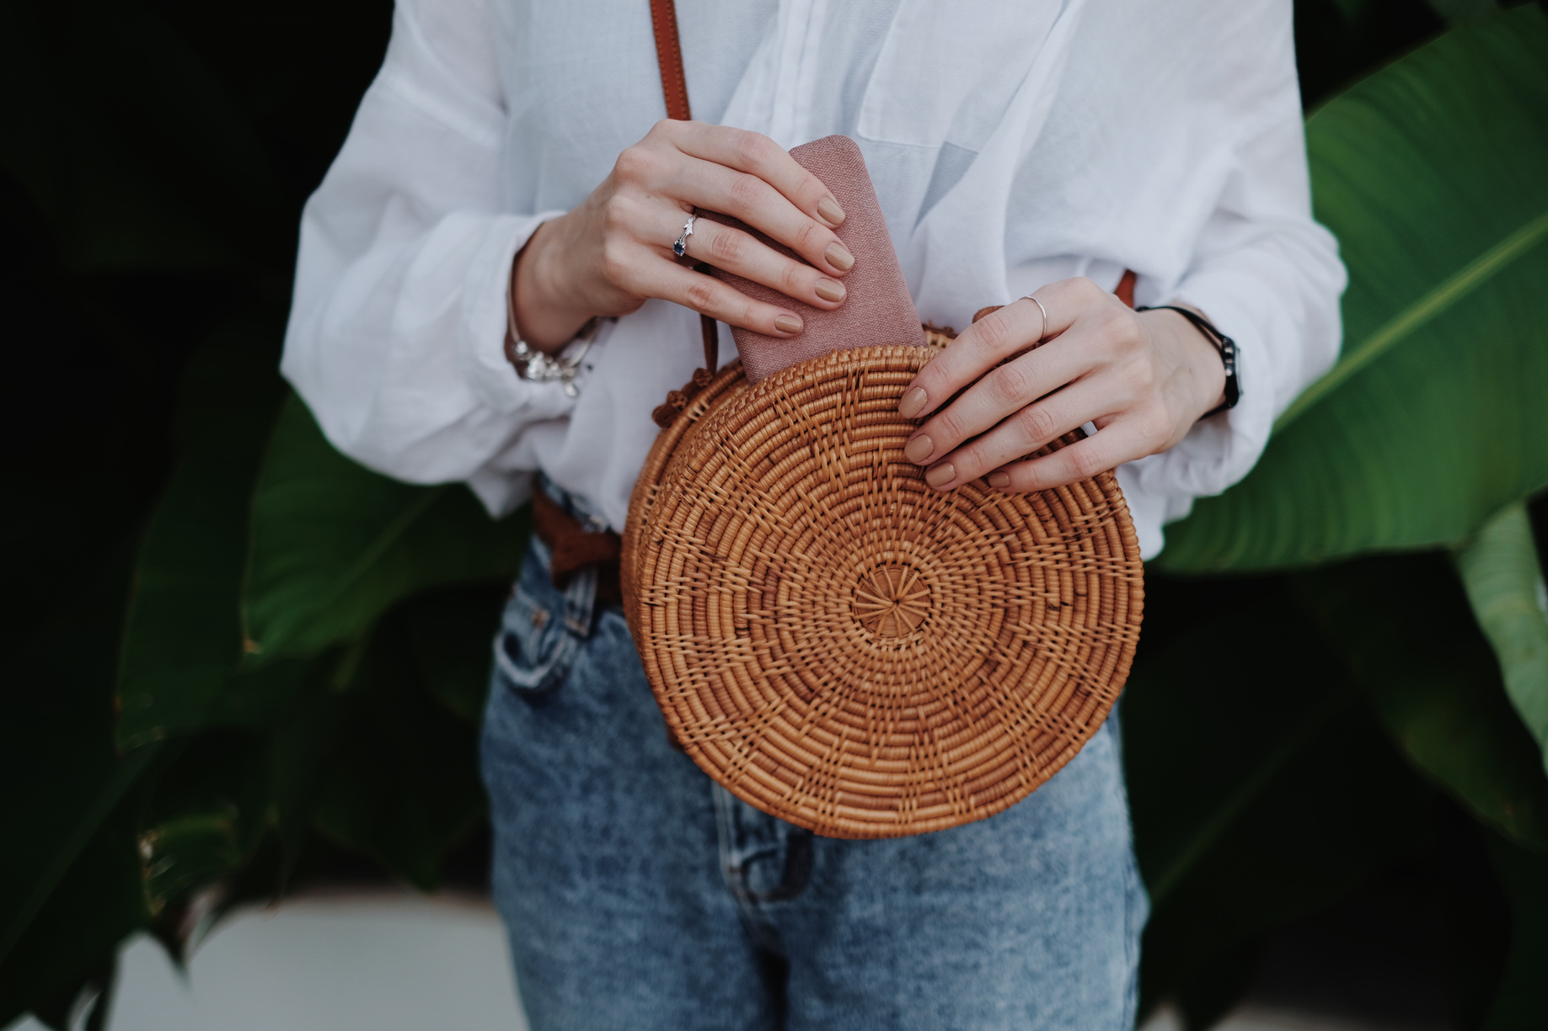
Within the shopping category, we want to identify which business type has received the most positive reviews and which has received the most negative reviews, as well as explore the reasons behind these ratings. The goal is to provide insights and recommendations to better understand consumer preferences and meet their needs.
Business Problem
Notes:
Within the shopping category, we want to identify which business type has received the most positive reviews and which has received the most negative reviews, as well as explore the reasons behind these ratings. The goal is to provide insights and recommendations to better understand consumer preferences and meet their needs.

Slide 5
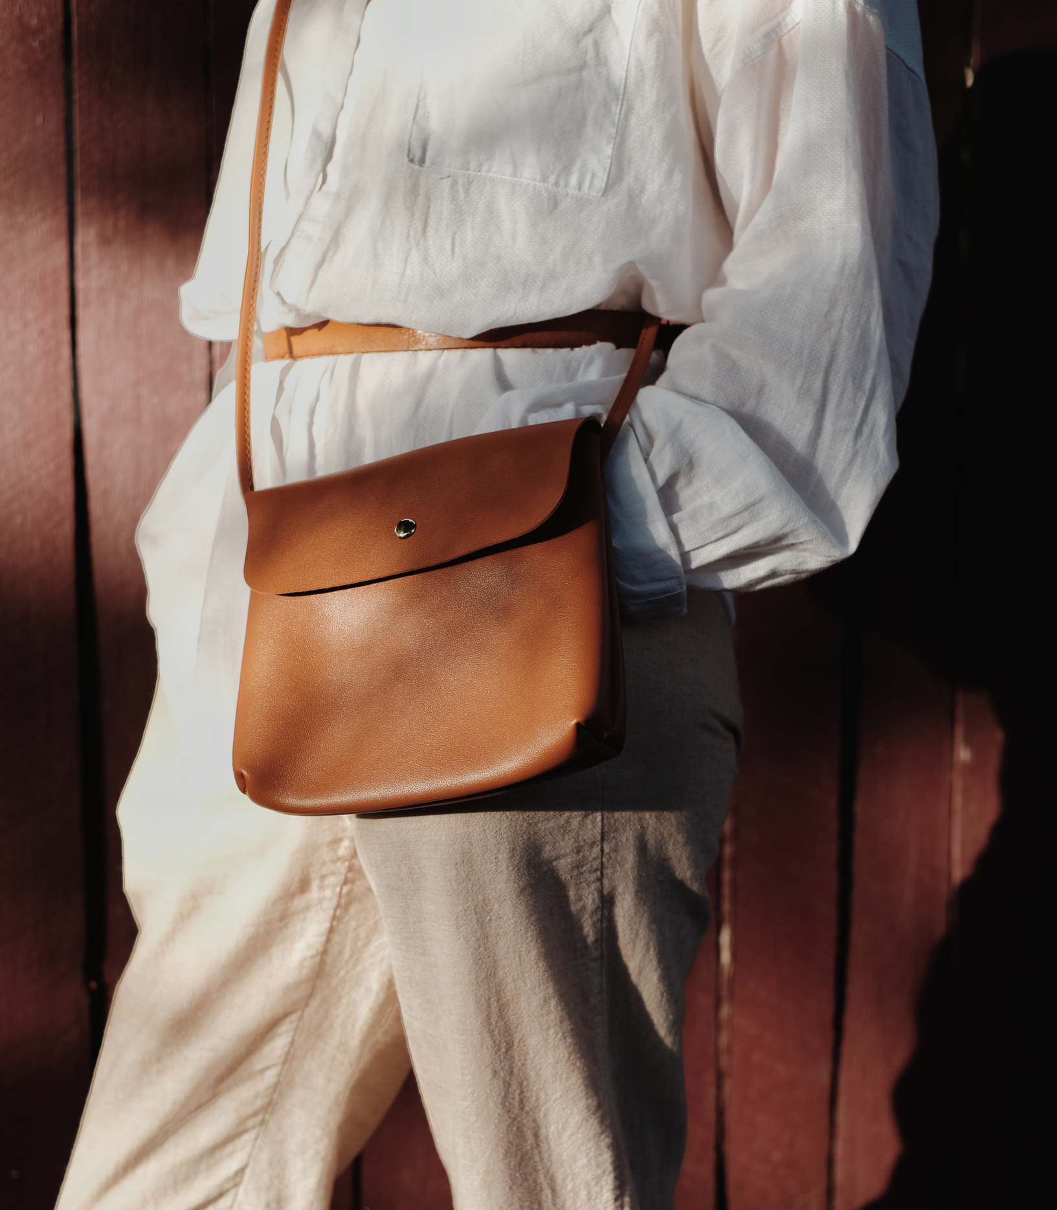
Data Preparation
Business file
Review file
Notes:
We used these 2 files for our project

Slide 6
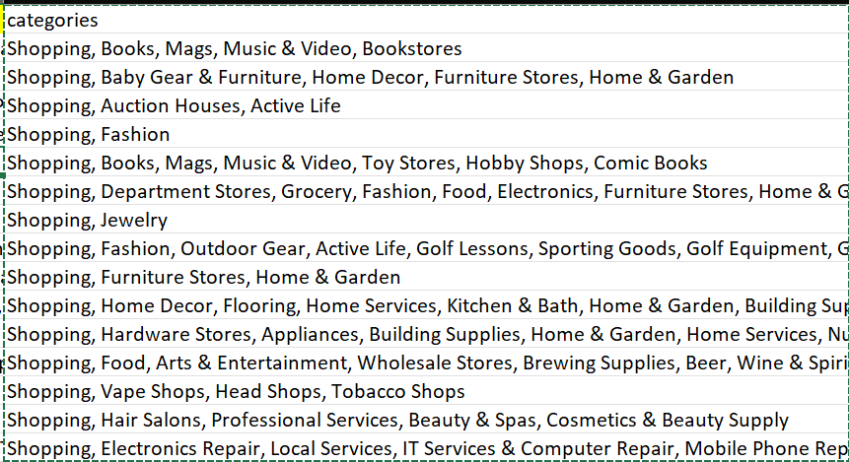
For Business file Preparation:
We first used Excel to filter out the shopping categories.

Slide 7
Since the classification of shopping areas was too complex, we first conducted a preliminary cluster analysis on the category column cells. We categorized them into four groups.
Categories
Books, Media & Hobby Shops
Fashion & Personal Goods Stores
Gifts, Florists & Specialty Shops
Home Improvement & Furniture Stores

Slide 8
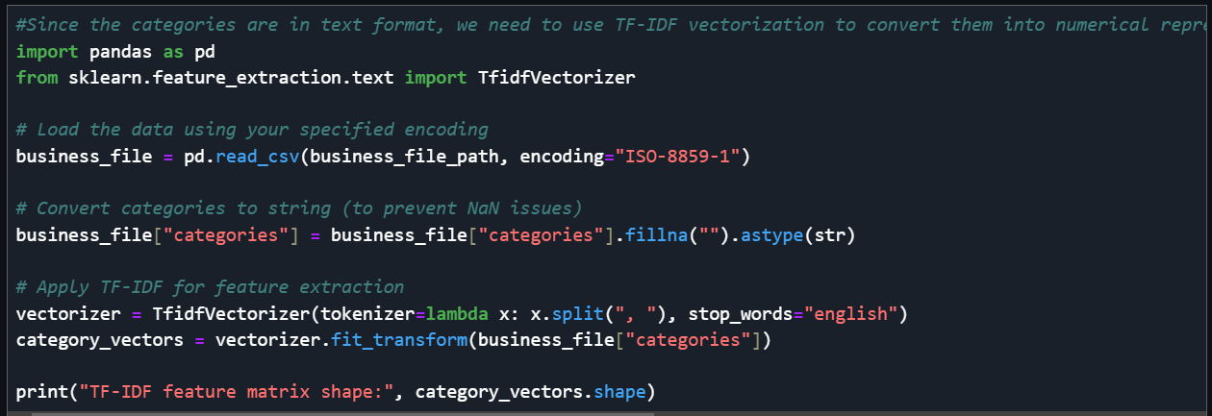
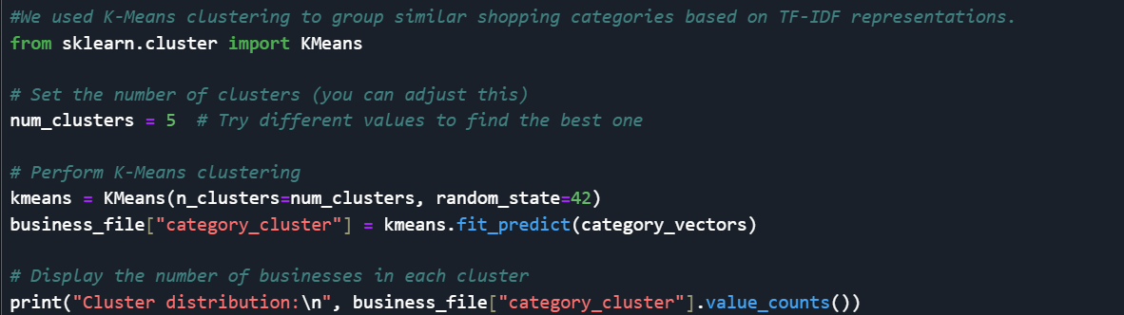
TF-IDF vectorization
K-Means
Notes:
#Since the categories are in text format, we need to use TF-IDF vectorization to convert them into numerical representations.
used K-Means clustering to group similar shopping categories based on TF-IDF representations.

Slide 9
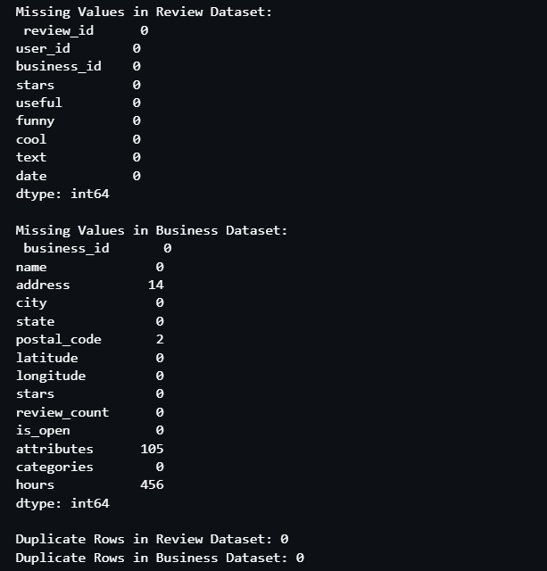
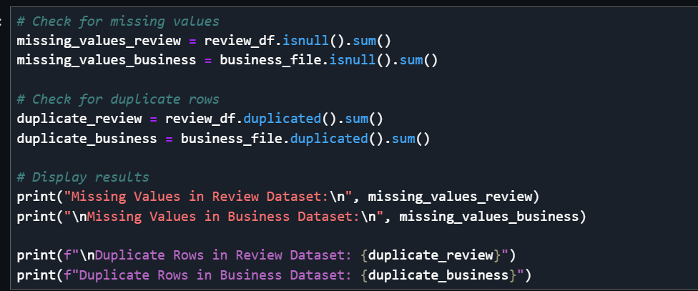
Processing and Cleaning
There are missing values in business file, but since the missing columns were not relevant to our analysis, we decided to keep them.
Notes:
we checked whether these two files had any missing or duplicate values. I found that the business file had missing values, but since the missing columns were not relevant to our analysis, we decided to keep them.

Slide 10
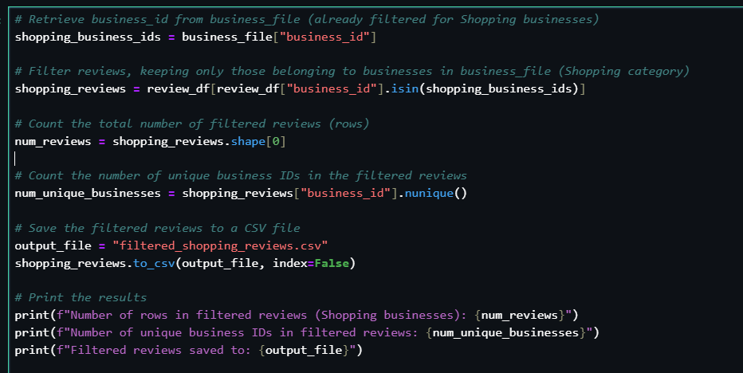
For Review file Preparation:
extract the business IDs from the review file that exist in the business file.
Notes:
Next, we need to extract the business IDs from the review file that exist in the business file.

Slide 11
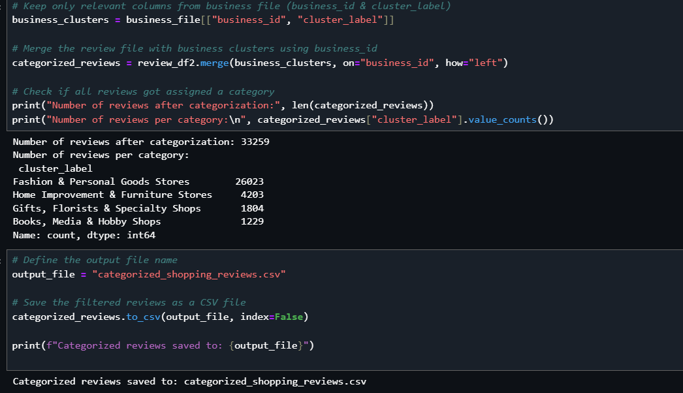

For Review file Preparation:
Add new columns for our new categories
Export as Excel.
Notes:
Add new columns for our new categories
The following analysis will focus on the review file because we are primarily interested in the text and ratings to better understand customer opinions.

Slide 12

Exploratory Data Analysis

Slide 13
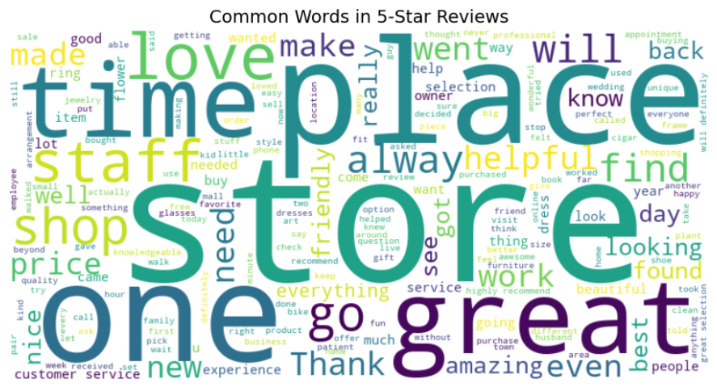
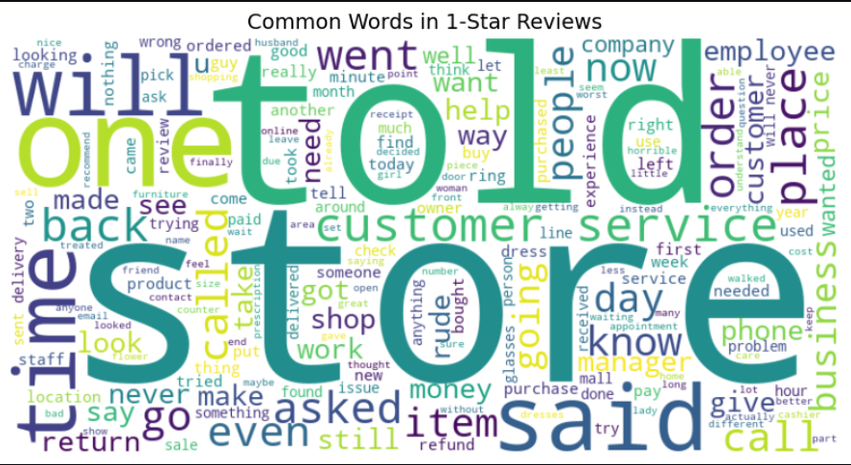
Word Cloud
5-star reviews highlight great customer service, helpful staff, and enjoyable shopping experiences.
1-star reviews focus on poor service, long wait times, and issues with orders or refunds.
Notes:
Customer service is a critical factor in both positive and negative reviews. Happy customers mention "staff" and "helpful," while unhappy ones emphasize "told," "asked," and "said"—implying conflicts or dissatisfaction with responses from store employees.Efficiency matters: Positive reviews highlight "time" in a general or enjoyable shopping sense, whereas negative reviews connect it with waiting issues or service delays.Order and refunds are pain points: Many negative reviews reference "order" and "refund," suggesting that issues with purchases, returns, or transactions are common reasons for dissatisfaction.

Slide 14
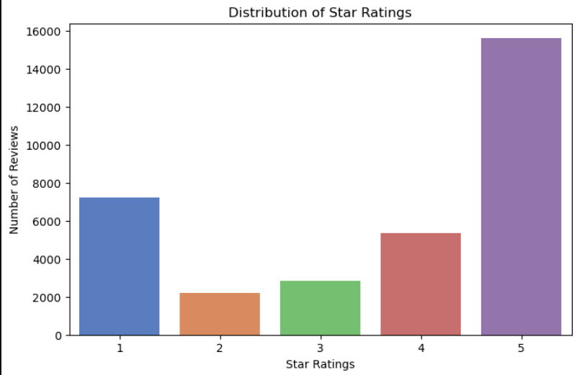
Star Rating Distribution
The majority of reviews are 5-star, indicating that most customers had a positive experience.
1-star reviews are the second most common, suggesting a mix of highly satisfied and dissatisfied customers.
Notes:
This Star Rating Distribution chart shows the number of reviews for each rating, ranging from 1 (worst) to 5 (best).
The majority of reviews are 5-star, indicating that most customers had a positive experience.
1-star reviews are the second most common, suggesting a mix of highly satisfied and dissatisfied customers.
The lower counts for 2-star and 3-star ratings imply that customers tend to either love or strongly dislike a product/service, with fewer neutral reviews.

Slide 15
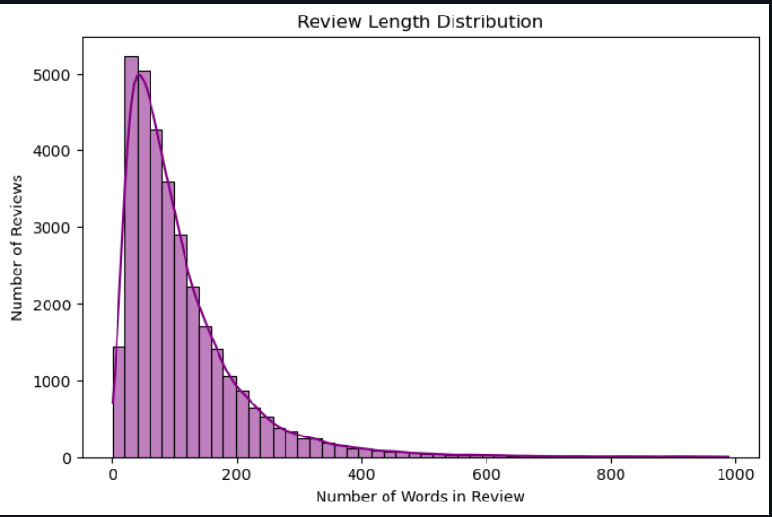
Review Length Distribution
Most reviews are short, typically under 100 words, indicating that customers tend to leave brief feedback.
Notes:
Most reviews are short, typically under 100 words, indicating that customers tend to leave brief feedback.
The right-skewed distribution implies that while short reviews are the norm, a small portion of users leave very detailed feedback.

Slide 16
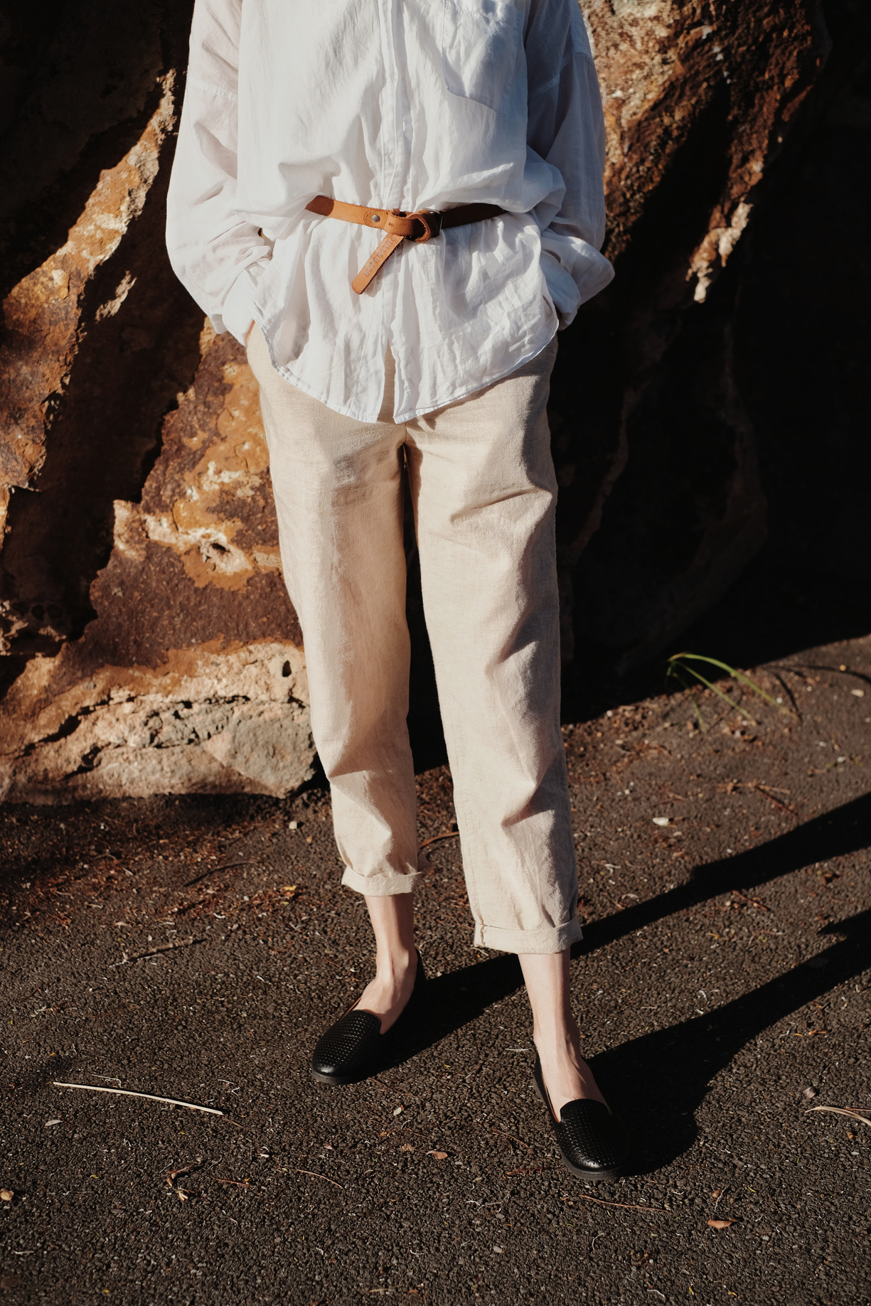
Sentimental Analysis
EDA

Slide 17
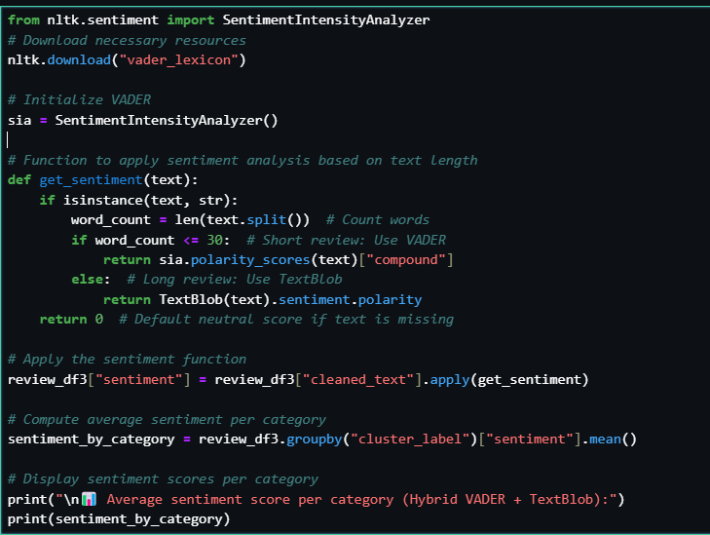
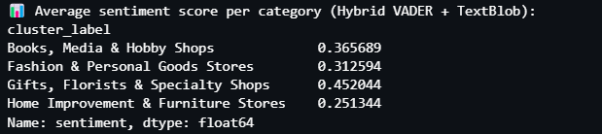
Use VADER + TextBlob
Sentiment Scores by Category
Notes:
VADER is Best for Short Texts (≤30 words)
TextBlob Works Better for Longer Texts (>30 words)
There are some text that are over 30 words, so we decide to you both method

Slide 18
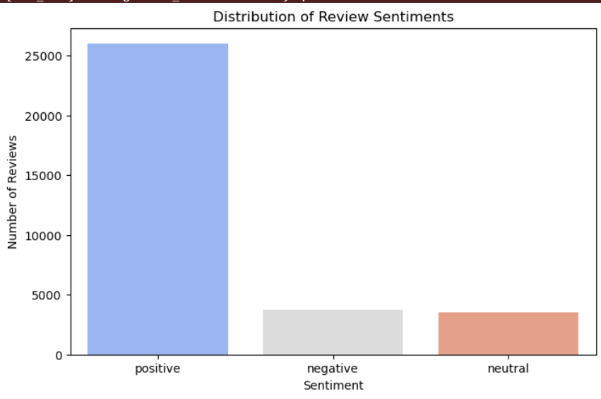
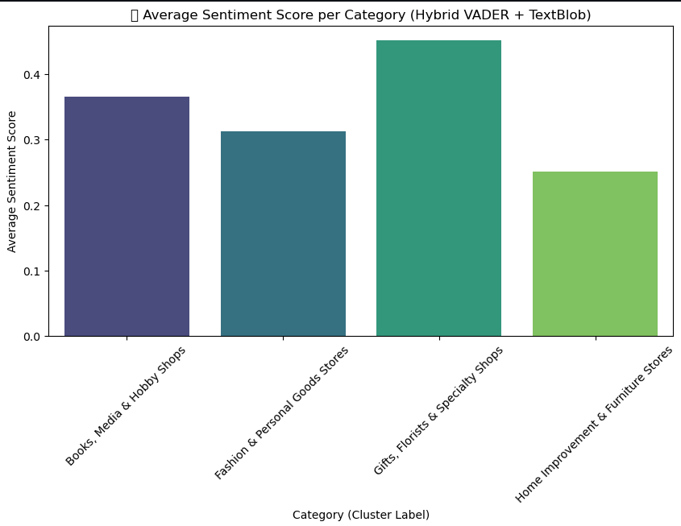
1️⃣ Most Reviews are Positive → The majority of customer reviews express satisfaction.
2️⃣ Few Negative Reviews → Complaints are relatively low, but still present.
Gifts, Florists & Specialty Shops have the highest sentiment.
Home Improvement & Furniture Stores have the lowest .
Notes:
What we got after we rated the reviews
Key Observations:1. Gifts, Florists & Specialty Shops has the highest sentiment score, suggesting that customers generally express the most positive sentiment when reviewing stores in this category.2. Home Improvement & Furniture Stores has the lowest sentiment score, which may indicate that customers tend to have more neutral or slightly negative experiences in this category.
2️⃣ Why Use TF-IDF in Sentiment Analysis?
✅ Extracts Important Words → Helps identify which words contribute most to sentiment

Slide 19
NLP Methodology

Slide 20
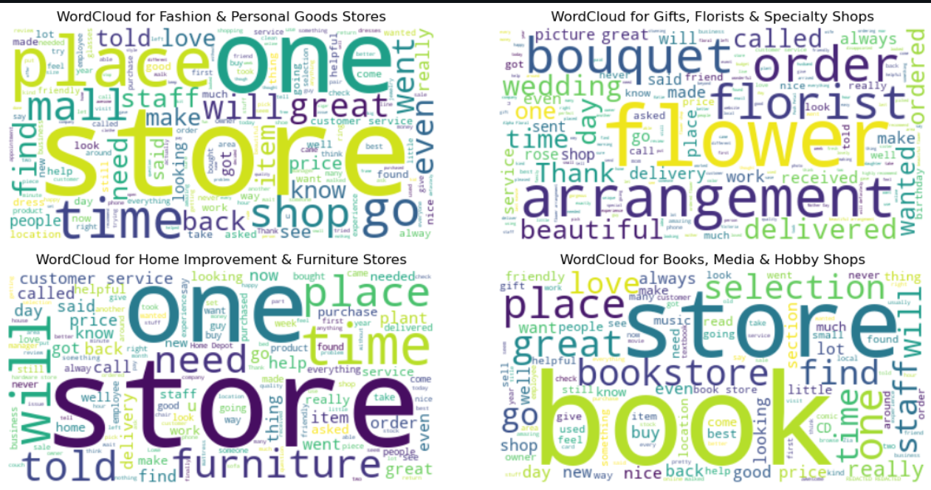
Notes:
Key Insights from the WordClouds:
Fashion & Personal Goods Stores
Most common words: "store," "place," "shop," "mall," "time," "staff," "find," "love"
Customers frequently talk about the store location (mall, place), shopping experience (find, shop), and customer service (staff, love, great).
Gifts, Florists & Specialty Shops
Most common words: "flower," "arrangement," "bouquet," "florist," "order," "delivered," "wedding," "beautiful"
This category has words related to flowers and gifts, with a strong focus on ordering, delivery, and special occasions (wedding, birthday).
Home Improvement & Furniture Stores
Most common words: "store," "one," "place," "time," "furniture," "need," "price," "customer service"
Discussions here are more practical, focusing on product needs (furniture, price, need) and customer service issues (called, told, help).
The presence of "delivery" suggests that logistics might be a key topic in reviews.
Books, Media & Hobby Shops
Most common words: "store," "book," "selection," "place," "great," "find," "love," "staff"
Customers frequently talk about book selection, shopping experience, and staff interactions.
Positive words like "love," "great," and "find" suggest an overall satisfying shopping experience.
Overall Takeaways:
Each category has distinct common keywords that highlight customer priorities.
Service and product quality are major themes across all categories.
Florists and bookstores tend to have more positive sentiment (words like "beautiful," "thank," "love"), while home improvement stores may have more concerns about price and customer service.
This visualization helps businesses understand customer focus areas and improve their services based on review themes. Let me know if you need a deeper analysis! 😊

Slide 21
Fashion & Personal Goods Stores: Customers frequently talk about the store location (mall, place), shopping experience (find, shop), and customer service (staff, love, great).
Gifts, Florists & Specialty Shops: This category has words related to flowers and gifts, with a strong focus on ordering, delivery, and special occasions (wedding, birthday).
Home Improvement & Furniture Stores :Here are more practical, focusing on product needs (furniture, price, need) and customer service issues (called, told, help).
Books, Media & Hobby Shops :Customers frequently talk about book selection, shopping experience, and staff interactions.

Slide 22
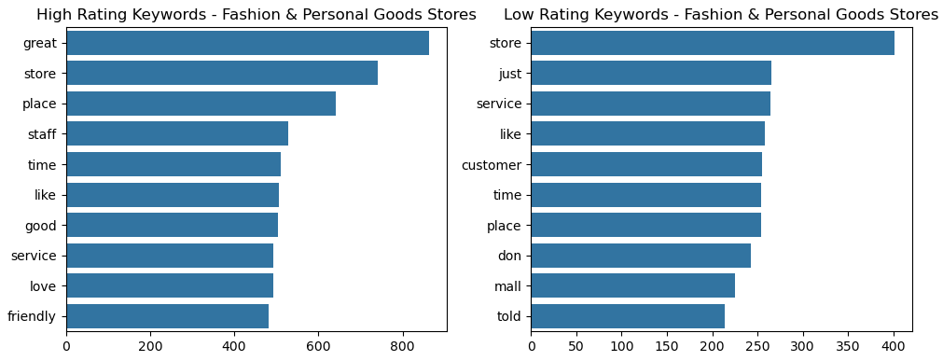
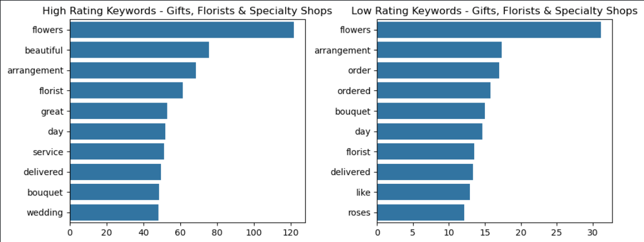
TF-IDF keyword analysis & BERT embeddings
Fashion & Personal Goods Stores
High Ratings:
Stores High Ratings: Customers appreciate friendly staff, great service, and good store experience.
Low Ratings:
Complaints about poor service, waiting time, and unclear communication.
Insight: Service quality is the key factor in ratings.
Gifts, Florists & Specialty Shops:
High Ratings:
Customers love beautiful flower arrangements, bouquets, and delivery service.
Low Ratings:
Complaints about order issues, late delivery, and product quality.
Insight: Delivery reliability is crucial for customer satisfaction.
Notes:
Fashion & Personal Goods Stores:
High-rating keywords: "great," "store," "place," "staff," "service," "friendly" – indicating a positive experience with store atmosphere and customer service.
Low-rating keywords: "store," "service," "customer," "mall," "told" – potential dissatisfaction with service, store experience, or misleading information.
Gifts, Florists & Specialty Shops:
High-rating keywords: "flowers," "beautiful," "arrangement," "florist," "wedding" – positive feedback on product aesthetics and special occasions.
Low-rating keywords: "flowers," "arrangement," "order," "delivered," "roses" – suggests issues with product quality, delivery, or unmet expectations.

Slide 23
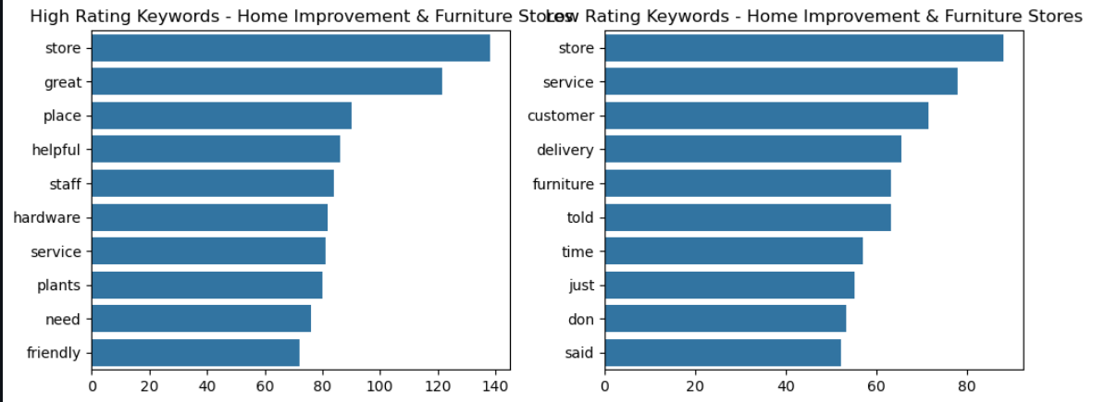
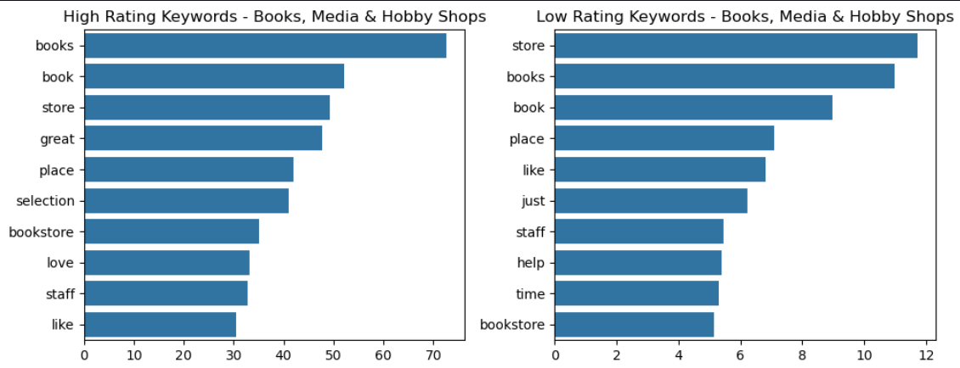
Home Improvement & Furniture Stores
High Ratings:
Customers value helpful staff, wide product selection (hardware, plants), and service.
Low Ratings:
Issues with delivery, furniture quality, and miscommunication.
Insight: Improving delivery service can boost ratings.
Books, Media & Hobby Shops
High Ratings:
Customers enjoy book selection, bookstore atmosphere, and helpful staff.
Low Ratings:
Complaints about slow service and unhelpful staff.
Insight: Better customer assistance can enhance experience.
Notes:
Home Improvement & Furniture Stores
High-rating keywords: "store," "great," "helpful," "staff," "friendly" – customers appreciate helpful staff and service.
Low-rating keywords: "store," "service," "customer," "delivery," "furniture" – issues with service, delivery, and product expectations.
Books, Media & Hobby Shops
High-rating keywords: "books," "selection," "great," "love," "staff" – positive reviews highlight book variety and store atmosphere.
Low-rating keywords: "store," "books," "place," "staff," "help" – dissatisfaction may be linked to customer service or inventory issues.
TF-IDFExtracts important words
BERT converts entire sentences into numerical vectors.
Since BERT embeddings are high-dimensional, t-SNE reduces them to 2D.

Slide 24
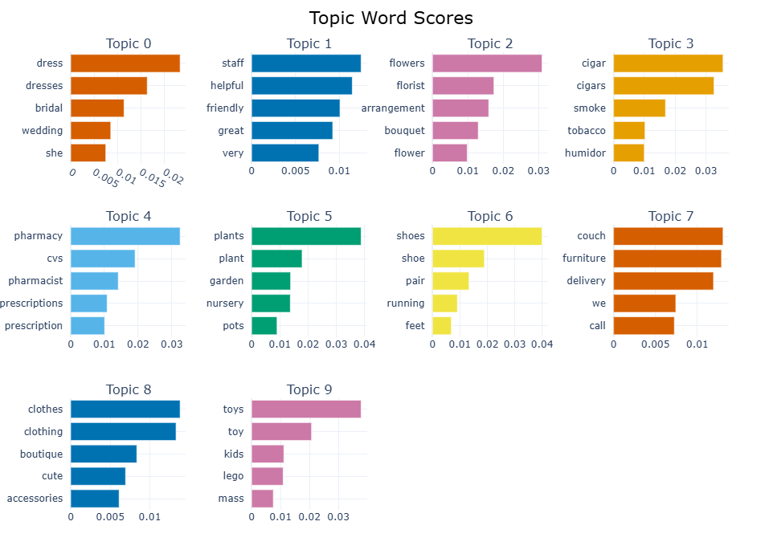
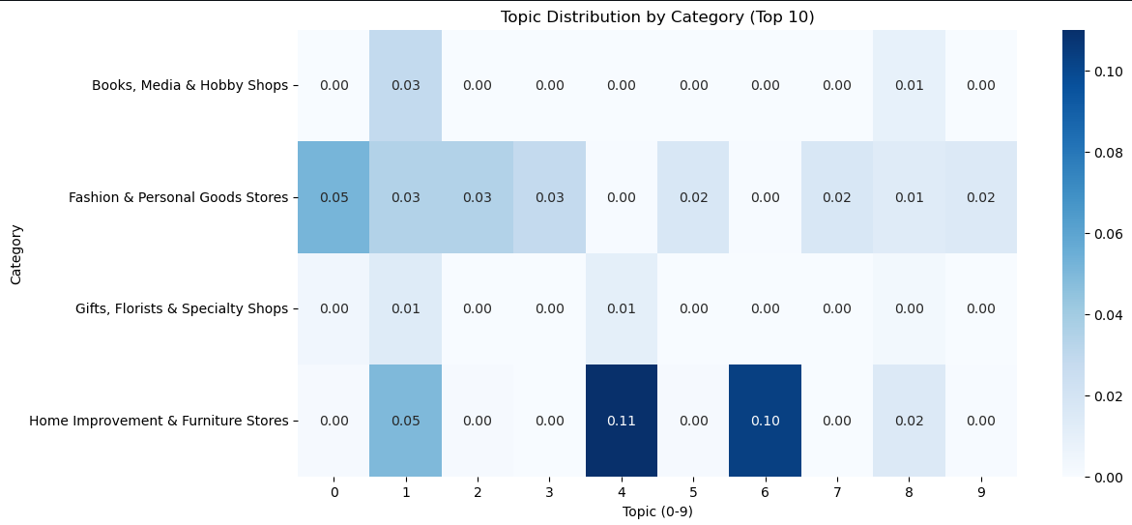
Fashion & Personal Goods Stores are associated with Topic 0 (dresses, bridal), Topic 1 (staff, helpful), and Topic 2 (flowers, arrangements), indicating a focus on customer service, clothing, and possibly floral products.
Home Improvement & Furniture Stores have a strong association with Topic 4 (pharmacy, prescriptions) and Topic 6 (shoes, running, feet), suggesting discussions around health-related items and footwear.
Gifts, Florists & Specialty Shops are linked to Topic 2 (flowers, bouquet, florist), which aligns well with their product offerings.
Books, Media & Hobby Shops show some presence in Topic 1 (staff, helpful) and Topic 5 (plants, garden), indicating that customer service and garden-related products might be part of discussions.
Notes:
we can identify what customers talk about the most and what they care about the most.
Them we found out how those topic relate to our categories
Distinct Topic Associations with Store Categories:
Fashion & Personal Goods Stores are associated with Topic 0 (dresses, bridal), Topic 1 (staff, helpful), and Topic 2 (flowers, arrangements), indicating a focus on customer service, clothing, and possibly floral products.
Home Improvement & Furniture Stores have a strong association with Topic 4 (pharmacy, prescriptions) and Topic 6 (shoes, running, feet), suggesting discussions around health-related items and footwear, which may be unexpected for this category.
Gifts, Florists & Specialty Shops are linked to Topic 2 (flowers, bouquet, florist), which aligns well with their product offerings.
Books, Media & Hobby Shops show some presence in Topic 1 (staff, helpful) and Topic 5 (plants, garden), indicating that customer service and garden-related products might be part of discussions.
📌 Topic 0 - Wedding Dresses & Bridal Wear🔑 Top words: "dress", "dresses", "bridal", "wedding", "she"Interpretation: This topic is related to wedding dresses and bridal fashion.Business Insight: Likely associated with fashion stores specializing in wedding attire.📌 Topic 1 - Customer Service & Staff Interactions🔑 Top words: "staff", "helpful", "friendly", "great", "very"Interpretation: This topic relates to customer service experiences.Business Insight: Good service seems to be a key theme; stores should focus on maintaining a helpful and friendly staff.📌 Topic 2 - Flowers & Floral Arrangements🔑 Top words: "flowers", "florist", "arrangement", "bouquet", "flower"Interpretation: Related to florists and flower delivery services.Business Insight: This topic suggests discussions about flower arrangements, bouquets, and quality of service in floral shops.📌 Topic 3 - Tobacco & Cigar Products🔑 Top words: "cigar", "cigars", "smoke", "tobacco", "humidor"Interpretation: Focuses on tobacco products and cigar stores.Business Insight: Retailers in this category should consider customer concerns about cigar quality, smoke experience, and storage (humidor usage).📌 Topic 4 - Pharmacies & Prescription Medications🔑 Top words: "pharmacy", "cvs", "pharmacist", "prescriptions", "prescription"Interpretation: Related to pharmacy services and medications.Business Insight: Likely reflects customer experiences in pharmacies, potentially about prescription fulfillment, customer service, or medication availability.📌 Topic 5 - Gardening & Plants🔑 Top words: "plants", "plant", "garden", "nursery", "pots"Interpretation: This topic relates to gardening and plant stores.Business Insight: Stores selling plants, gardening supplies, and plant nurseries can use this insight to target their marketing toward gardening enthusiasts.📌 Topic 6 - Shoes & Footwear🔑 Top words: "shoes", "shoe", "pair", "running", "feet"Interpretation: Focuses on footwear, running shoes, and shoe stores.Business Insight: Likely represents customer feedback on shoe comfort, performance, or style preferences.📌 Topic 7 - Furniture & Home Delivery🔑 Top words: "couch", "furniture", "delivery", "we", "call"Interpretation: Discusses home furniture and delivery services.Business Insight: This suggests customers frequently talk about delivery experiences when purchasing furniture. Retailers should focus on fast & reliable delivery.📌 Topic 8 - Clothing & Fashion🔑 Top words: "clothes", "clothing", "boutique", "cute", "accessories"Interpretation: Related to fashion and clothing stores.Business Insight: Customers likely discuss trendy clothing items, boutique experiences, and accessories.📌 Topic 9 - Toys & Kids’ Products🔑 Top words: "toys", "toy", "kids", "lego", "mass"Interpretation: Covers children’s toys, games, and products for kids.Business Insight: Likely discussions about popular toys (e.g., LEGO), children’s stores, and toy shopping experiences.

Slide 25
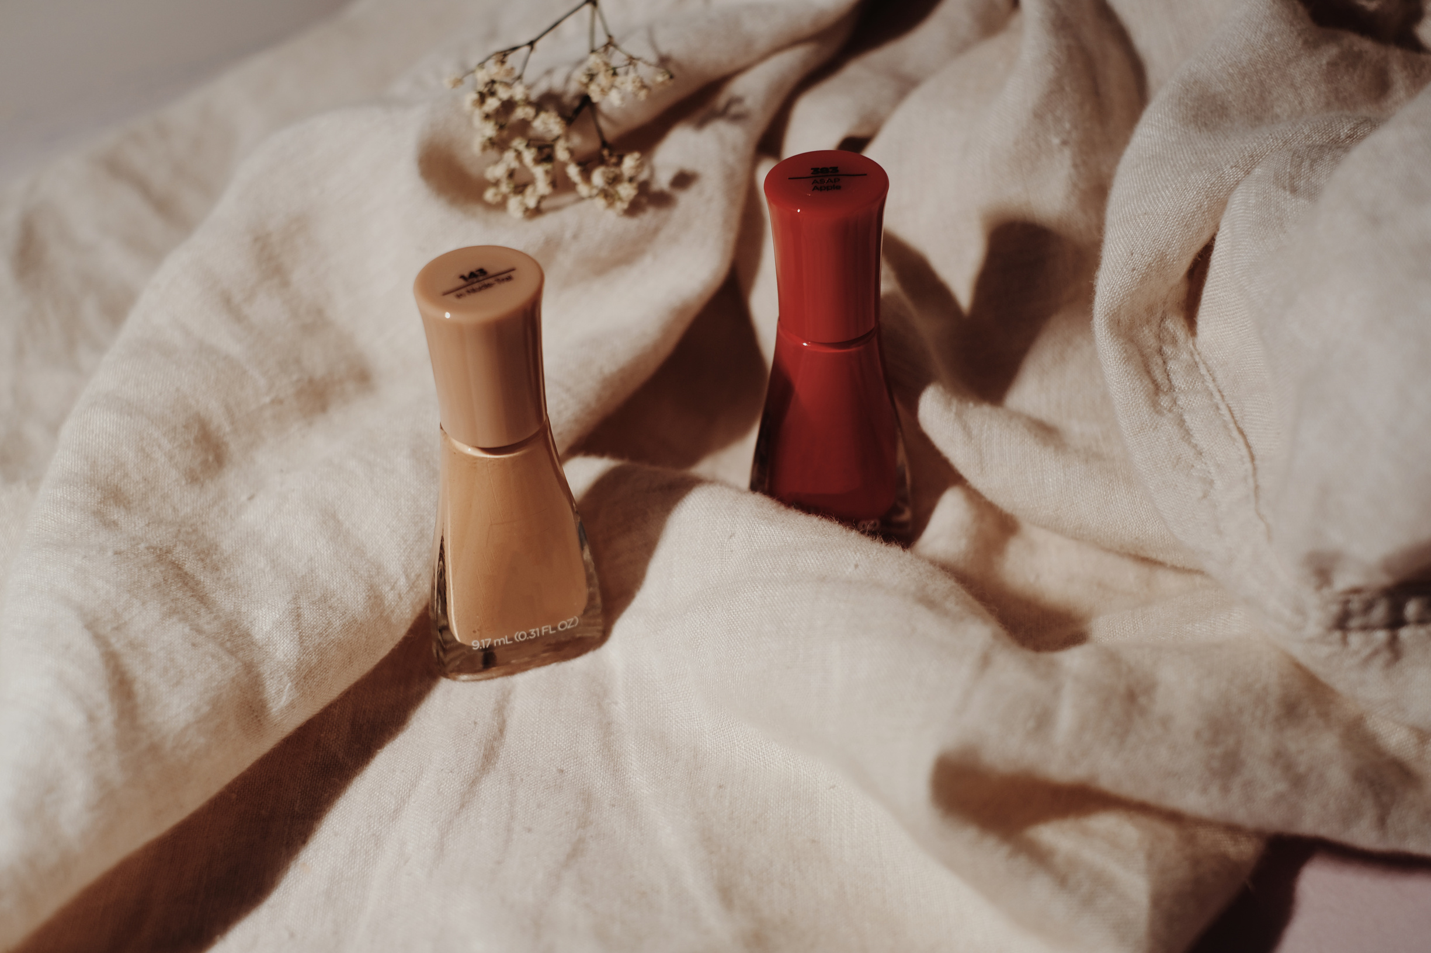
Business Insights
& Recommendations

Slide 26

Customer Service is a Critical Factor Across Stores
Delivery & Logistics Issues in Furniture Stores
Topic 7 ("couch," "furniture," "delivery") is strongly associated with Home Improvement & Furniture Stores.
This matches our earlier observation that delivery problems contribute to negative reviews in furniture stores.
Fashion Stores Are Highly Associated with Clothing & Shopping Experience
This suggests that fashion-related terms dominate customer discussions, supporting the idea that product variety and style trends are important.
Florists & Gift Shops Focus on Product Presentation
Topic 2 ("flowers," "florist," "arrangement") aligns with Gifts, Florists & Specialty Shops, showing that floral arrangements and presentation are key drivers of customer sentiment.
Notes:
Key Insights from the Added Topic Modeling Data:
Customer Service is a Critical Factor Across Stores
Topic 1 ("staff," "helpful," "friendly") is notably present in Fashion & Personal Goods Stores and Home Improvement & Furniture Stores.
This reinforces our previous finding that good customer service significantly impacts positive reviews.
Delivery & Logistics Issues in Furniture Stores
Topic 7 ("couch," "furniture," "delivery") is strongly associated with Home Improvement & Furniture Stores.
This matches our earlier observation that delivery problems contribute to negative reviews in furniture stores.
Recommendation: Improve logistics, communication, and quality control in delivery services.
Fashion Stores Are Highly Associated with Clothing & Shopping Experience
Topic 0 ("dress," "bridal," "wedding") and Topic 8 ("clothes," "boutique") are linked to Fashion & Personal Goods Stores.
This suggests that fashion-related terms dominate customer discussions, supporting the idea that product variety and style trends are important.
Recommendation: Ensure up-to-date fashion collections and maintain consistent product quality to meet customer expectations.
Florists & Gift Shops Focus on Product Presentation
Topic 2 ("flowers," "florist," "arrangement") aligns with Gifts, Florists & Specialty Shops, showing that floral arrangements and presentation are key drivers of customer sentiment.
Since similar words appear in both high and low ratings, some customers may be disappointed if the delivered product doesn’t match expectations.
Recommendation: Ensure product images accurately reflect the actual arrangements and improve packaging & delivery quality.
Bookstores Have Minimal Distinct Topics
The Books, Media & Hobby Shops category lacks strong topic associations, except for a small presence in Topic 1 (customer service).
This suggests that bookstore reviews may be more general and less issue-specific compared to other store types.
Unexpected Pharmacy Mentions in Home Improvement Stores
Topic 4 ("pharmacy," "prescriptions") is strongly present in Home Improvement & Furniture Stores.
This might be due to:
Certain home improvement stores selling medical or wellness-related products.
Customer discussions mentioning prescription-related frustrations.
Recommendation: Investigate why pharmacy-related terms appear and ensure clear product categorization.

Slide 27

5. Bookstores Have Minimal Distinct Topics
The Books, Media & Hobby Shops category lacks strong topic associations, except for a small presence in Topic 1 (customer service).
This suggests that bookstore reviews may be more general and less issue-specific compared to other store types.
6. Unexpected Pharmacy Mentions in Home Improvement Stores
Topic 4 ("pharmacy," "prescriptions") is strongly present in Home Improvement & Furniture Stores.
This might be due to:
Certain home improvement stores selling medical or wellness-related products.
Customer discussions mentioning prescription-related frustrations.
Notes:
Key Insights from the Added Topic Modeling Data:
Customer Service is a Critical Factor Across Stores
Topic 1 ("staff," "helpful," "friendly") is notably present in Fashion & Personal Goods Stores and Home Improvement & Furniture Stores.
This reinforces our previous finding that good customer service significantly impacts positive reviews.
Delivery & Logistics Issues in Furniture Stores
Topic 7 ("couch," "furniture," "delivery") is strongly associated with Home Improvement & Furniture Stores.
This matches our earlier observation that delivery problems contribute to negative reviews in furniture stores.
Recommendation: Improve logistics, communication, and quality control in delivery services.
Fashion Stores Are Highly Associated with Clothing & Shopping Experience
Topic 0 ("dress," "bridal," "wedding") and Topic 8 ("clothes," "boutique") are linked to Fashion & Personal Goods Stores.
This suggests that fashion-related terms dominate customer discussions, supporting the idea that product variety and style trends are important.
Recommendation: Ensure up-to-date fashion collections and maintain consistent product quality to meet customer expectations.
Florists & Gift Shops Focus on Product Presentation
Topic 2 ("flowers," "florist," "arrangement") aligns with Gifts, Florists & Specialty Shops, showing that floral arrangements and presentation are key drivers of customer sentiment.
Since similar words appear in both high and low ratings, some customers may be disappointed if the delivered product doesn’t match expectations.
Recommendation: Ensure product images accurately reflect the actual arrangements and improve packaging & delivery quality.
Bookstores Have Minimal Distinct Topics
The Books, Media & Hobby Shops category lacks strong topic associations, except for a small presence in Topic 1 (customer service).
This suggests that bookstore reviews may be more general and less issue-specific compared to other store types.
Unexpected Pharmacy Mentions in Home Improvement Stores
Topic 4 ("pharmacy," "prescriptions") is strongly present in Home Improvement & Furniture Stores.
This might be due to:
Certain home improvement stores selling medical or wellness-related products.
Customer discussions mentioning prescription-related frustrations.
Recommendation: Investigate why pharmacy-related terms appear and ensure clear product categorization.

Slide 28
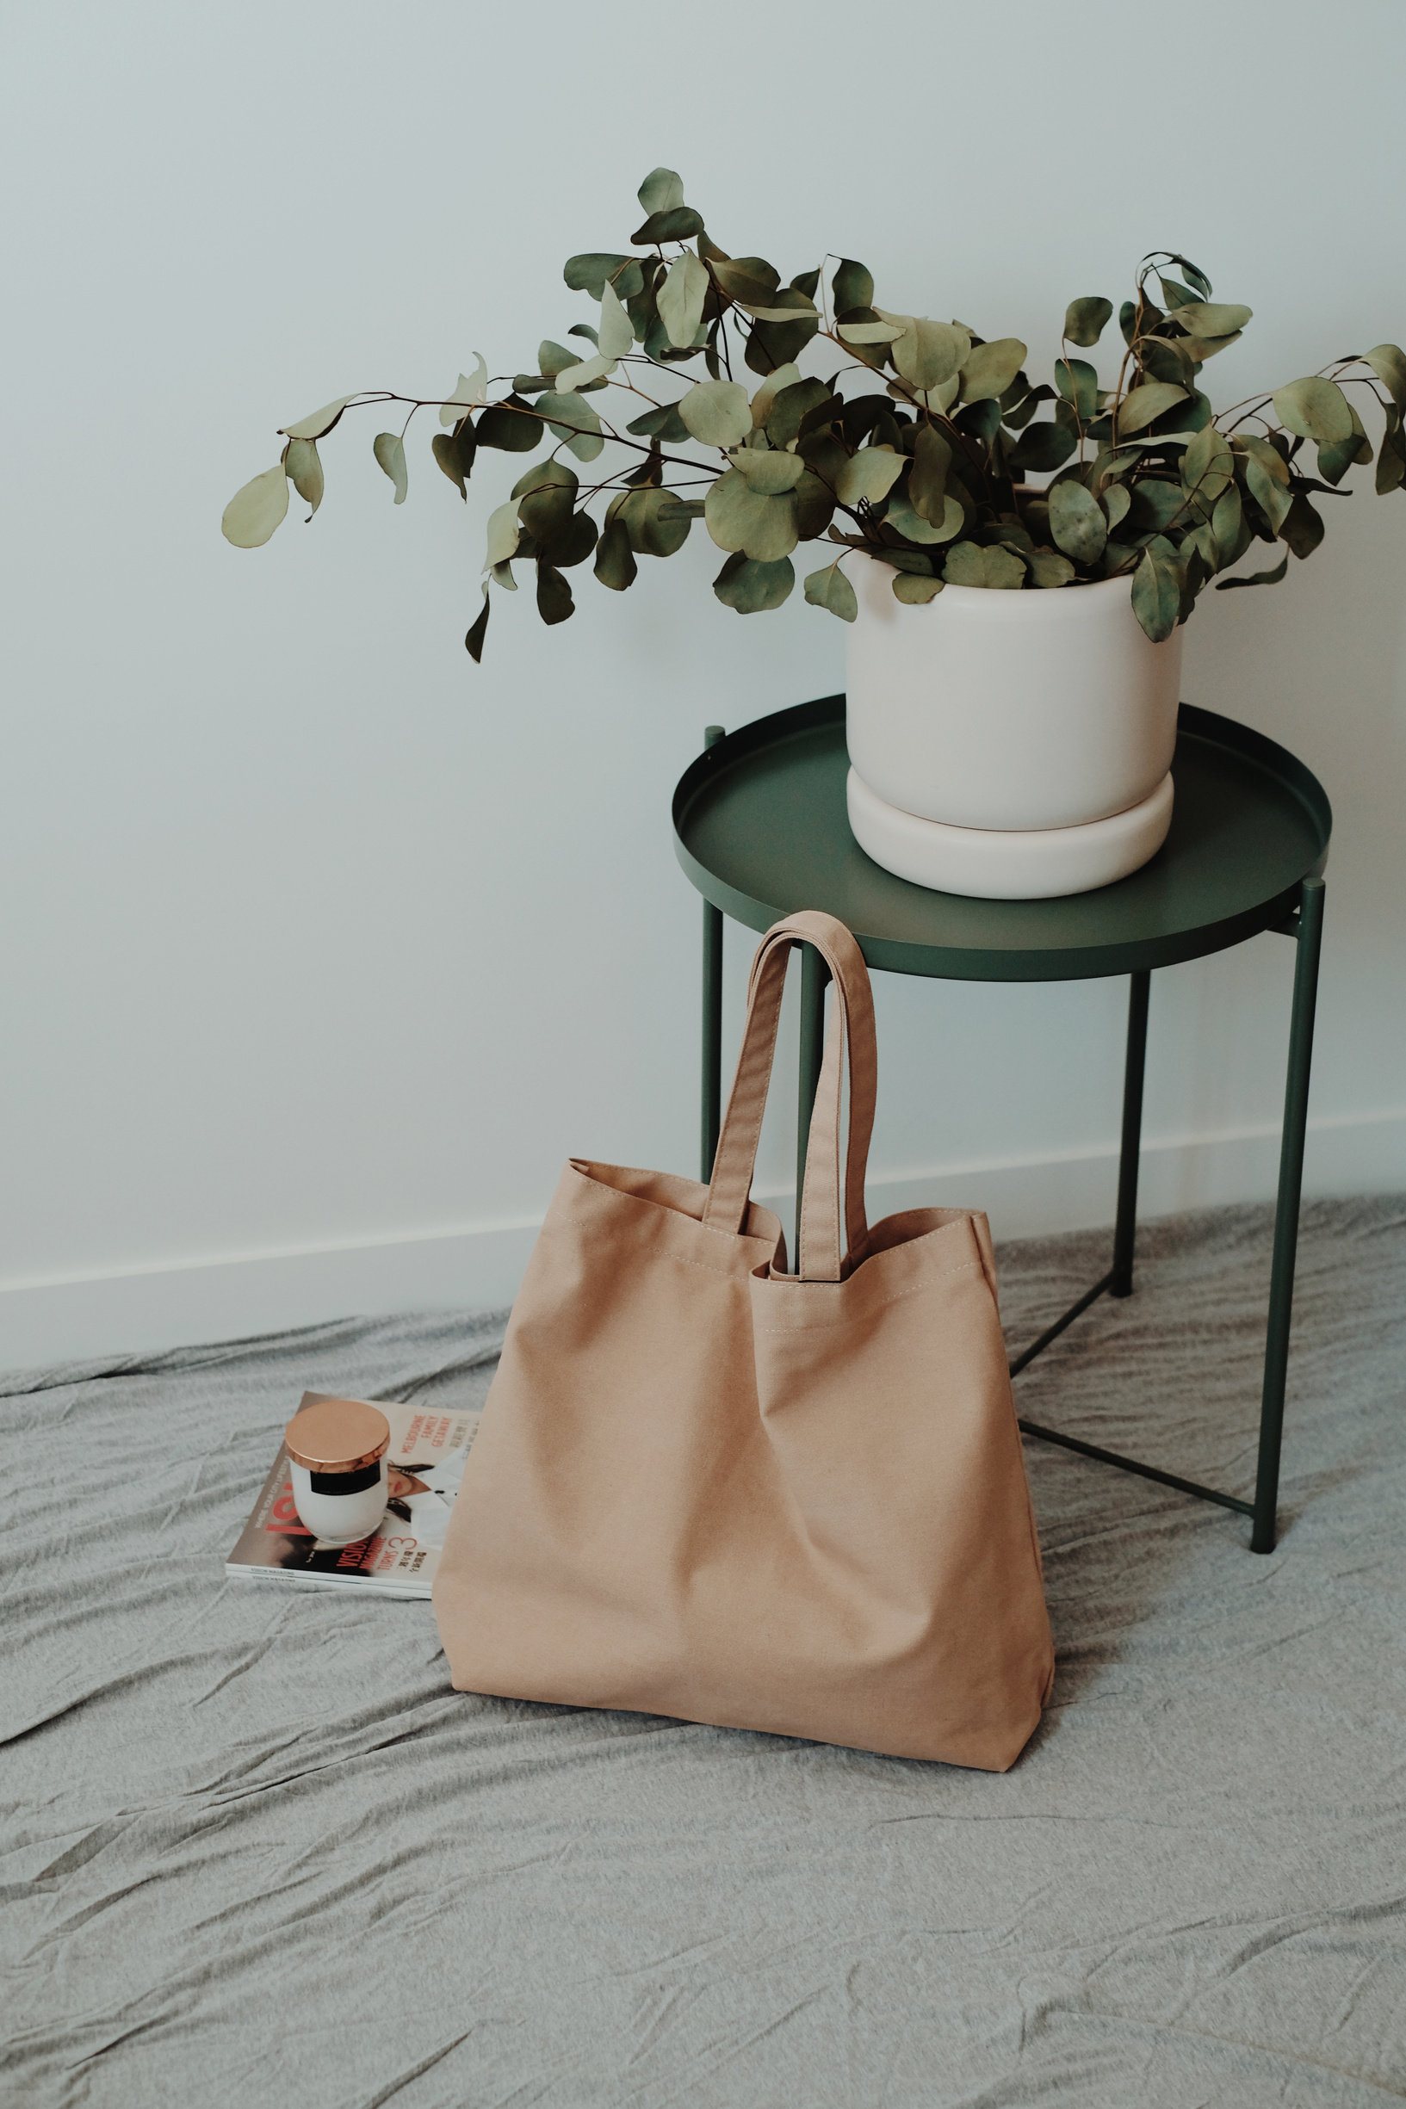
Recommendations:
1. Improve Customer Service Across All Categories
Continue training staff to be more helpful and responsive.
Prioritize in-store and online customer support.
2. Enhance Delivery & Order Fulfillment (Especially for Furniture & Florists)
Address delivery delays and product discrepancies.
Implement better tracking and communication for customers.
3. Ensure Product Consistency & Expectations Management
In fashion stores, maintain quality control to avoid mismatched expectations.
In gift & florists, showcase real customer images to prevent dissatisfaction.
4. Investigate Unexpected Pharmacy Mentions in Home Improvement Stores
Determine if it’s related to actual product offerings or unrelated discussions in reviews.

Slide 29

Q & A

